Slide 2
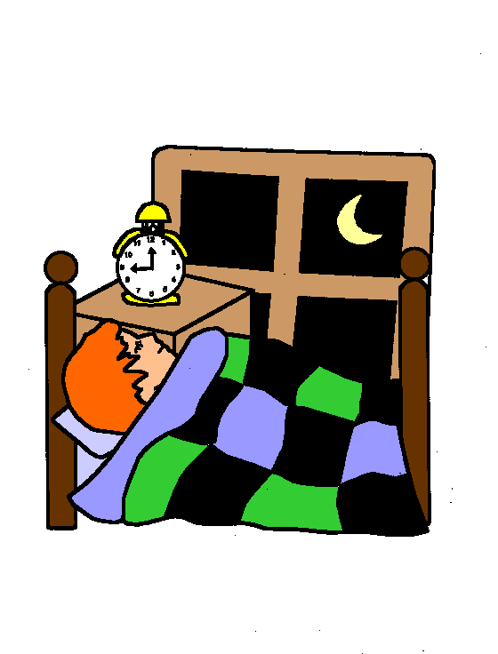
Time for bed.

Slide 3
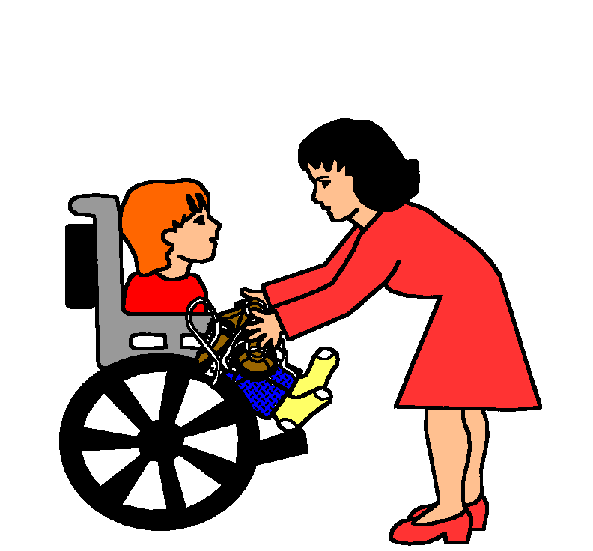
Take off shoes.

Slide 4
Time for bed.

Slide 5
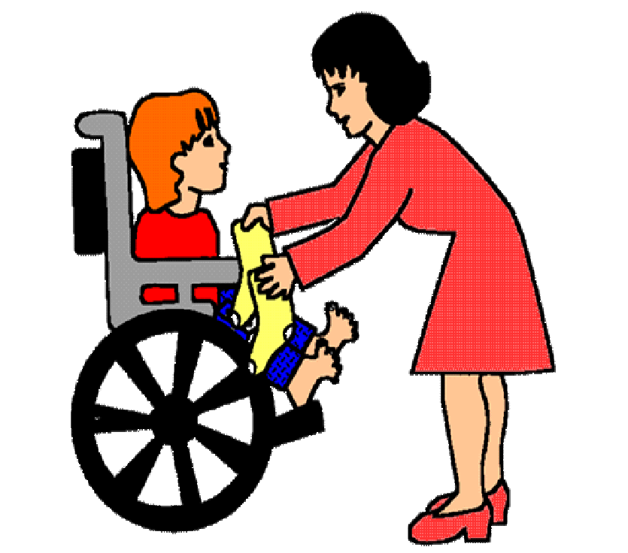
Take off socks.

Slide 6
Time for bed.

Slide 7
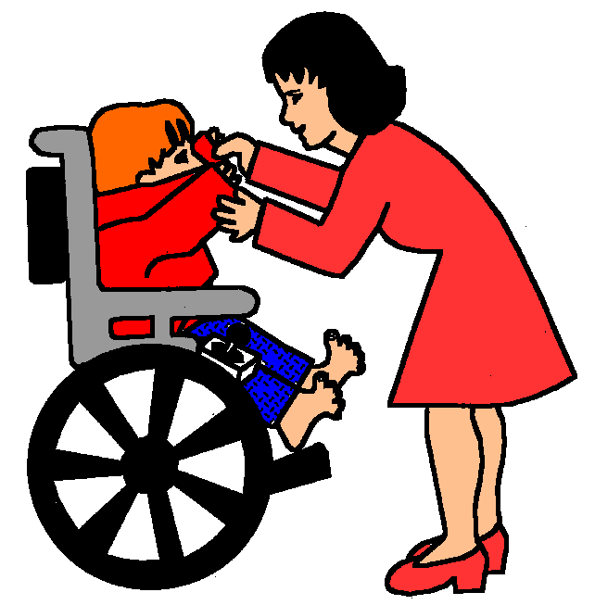
Take off shirt.

Slide 8
Time for bed.

Slide 9
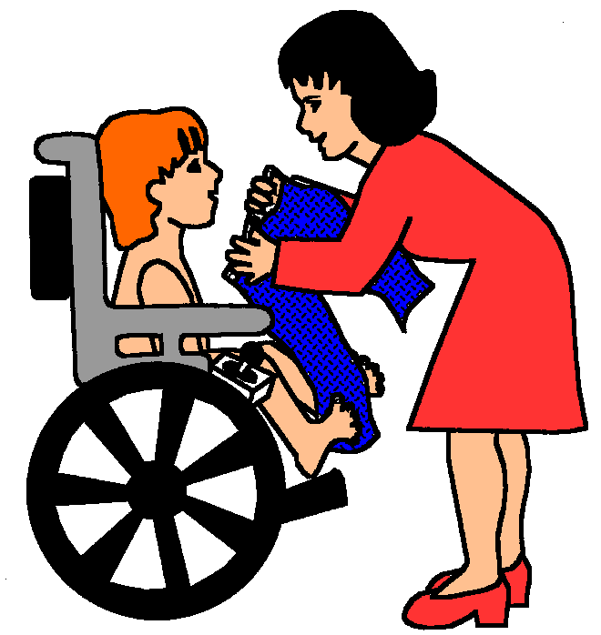
Take off pants.

Slide 10
Time for bed.

Slide 11
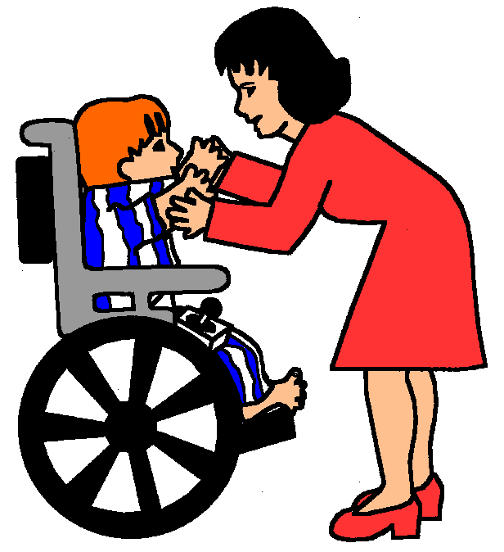
Put on pajamas.

